Slide 1
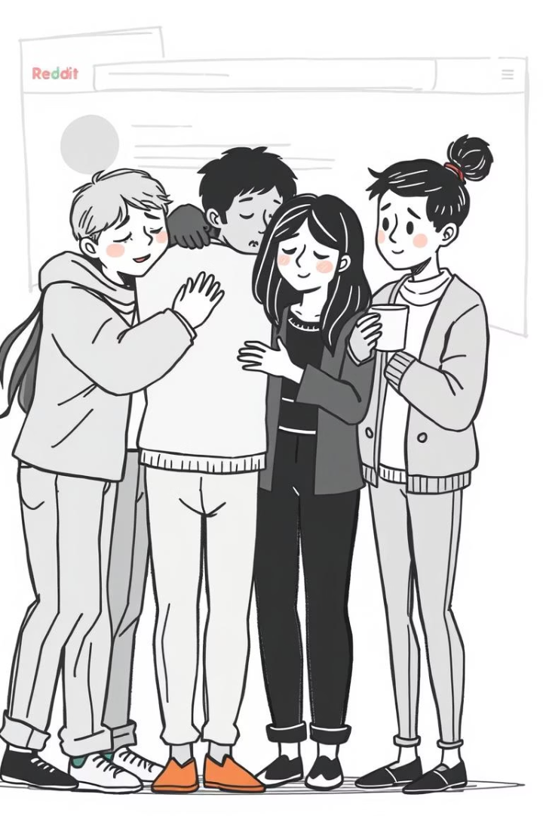
Understanding COVID-19's Impact on Mental Health: A Reddit-Based Analysis
This presentation explores the profound impact of the COVID-19 pandemic on mental health, leveraging user-generated content from Reddit. We employ advanced analytical methods, including natural language processing (NLP), topic modeling, and machine learning, to uncover trends and patterns within mental health subreddits. Our findings offer insights valuable to clinicians, researchers, and policymakers, highlighting the importance of social media as a real-time indicator of public sentiment.
Mitul Vashista
(B20AI022)

Slide 2
Contents
An overview of the presentation's structure and key topics.
What is Reddit ?
1
Why use Reddit for Mental Health Analysis ?
Data Collection and Preprocessing
Gathering and cleaning Reddit data.
Sentiment and Emotion Analysis
Techniques and applications.
Topic Modeling with LDA
Uncovering key themes.
SBERT Embeddings and Clustering
Semantic analysis of text data.
Classification with Random Forest
Predictive modeling techniques.
Sentiment Trends and Emotion Distribution
Visualizing changes over time.
UMAP Clustering and Word Clouds
Visualizing data relationships.
Key Results and Discussion
Insights and implications.
Conclusion and Future Work
Summary and next steps.

Slide 3

What is Reddit ?
Reddit is a large social media platform where users post and discuss content in topic-specific forums called subreddits.
Each subreddit is a community built around a common interest or theme.
Why use Reddit for Mental Health Analysis
Anonymity
Anonymity encourages openness about sensitive issues like mental health.
Rich Narratives
Rich, unfiltered user narratives provide deeper emotional and psychological insights.
Support Networks
Mental health subreddits (e.g., r/depression, r/Anxiety, r/SuicideWatch) serve as support networks with daily activity.

Slide 4
Data Collection and Preprocessing
Dataset Overview
Preprocessing Steps
We gathered Reddit posts from five mental health subreddits (depression, Anxiety, mentalhealth, SuicideWatch, bipolar) using the PRAW API. A keyword search for "covid" yielded approximately 5000 posts per subreddit, covering early 2020 to early 2025.
Data cleaning involved removing URLs, converting text to lowercase, and eliminating stopwords. Text tokenization and lemmatization were applied using Python. This rigorous process ensured the dataset was optimized for subsequent analysis.

Slide 5
Sample Data
Review sample data from three subreddits post-preprocessing.
Subreddit
Post_ID
Date
Text
Processed_Text
depression
abc123
2021-05-01
I feel so lost during covid.
feel lost covid
Anxiety
def456
2020-07-20
COVID has worsened my anxiety.
covid worsened anxiety
mentalhealth
ghi789
2022-03-14
Struggling with isolation again.
struggling isolation again

Slide 6

Sentiment and Emotion Analysis
1
Sentiment Scoring
Sentiment scores were derived using the syuzhet package in R, employing lexicons such as Bing, Afinn, and Syuzhet. This provided a nuanced understanding of the emotional tone in the posts.
2
Emotion Classification
Emotional classification was performed using the NRC Emotion Lexicon, which yielded scores for emotions such as joy, sadness, trust, and fear. This allowed us to identify dominant emotions within each subreddit.

Slide 7
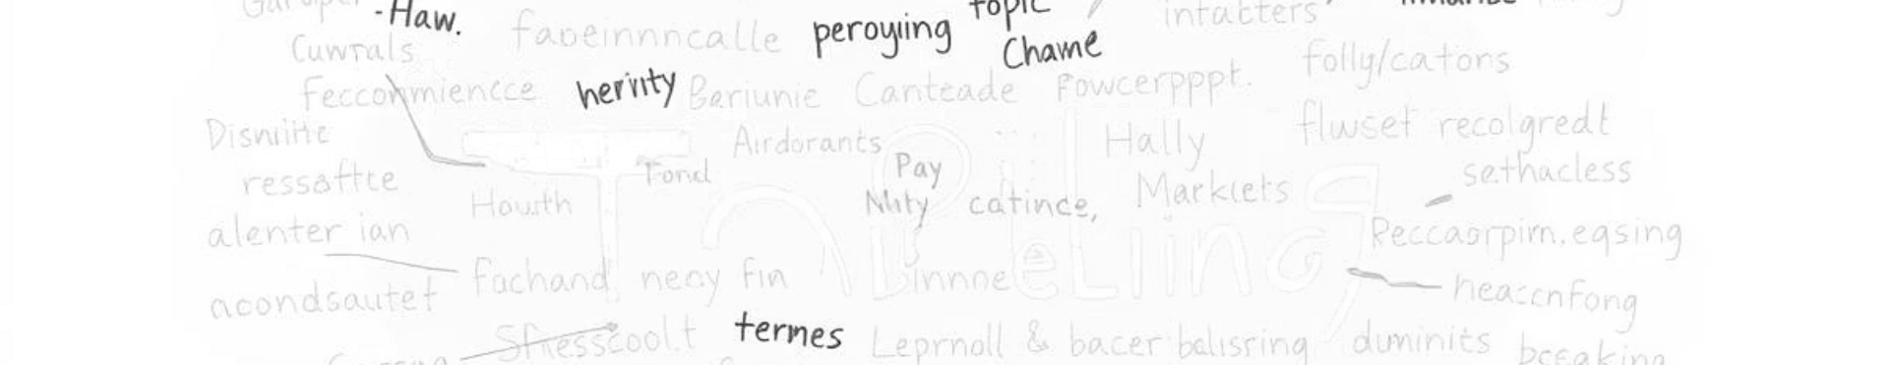
Topic Modeling with Latent Dirichlet Allocation (LDA)
Dominant Themes
Coherence Scores
LDA extracted key themes such as anxiety, job loss, emotional dysregulation, and medication effects across subreddits. These themes highlight the most pressing concerns during the pandemic.
The number of topics per subreddit was determined using coherence scores, ensuring the identified topics were both meaningful and representative of the discussions.

Slide 8
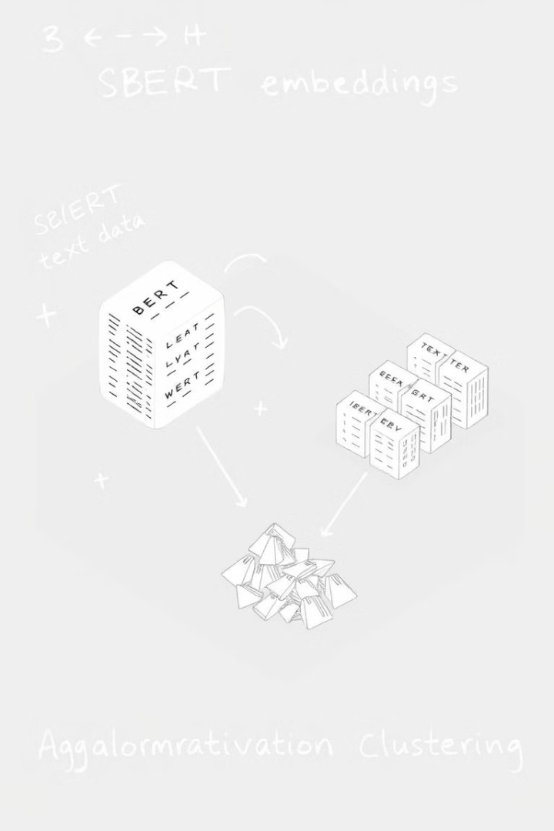
SBERT Embeddings and Clustering
1
Text Embeddings
SBERT (all-MiniLM-L6-v2 model) generated text embeddings, capturing semantic information from the Reddit posts. This facilitated advanced clustering and analysis.
2
Dimensionality Reduction
UMAP reduced dimensionality, enabling clearer visualization and more effective clustering. This step was crucial for identifying latent structures in the data.
3
Agglomerative Clustering
Agglomerative Clustering (Ward linkage) identified five distinct clusters, each representing underlying themes in the discussions. These clusters provided a nuanced understanding of the mental health landscape.

Slide 9

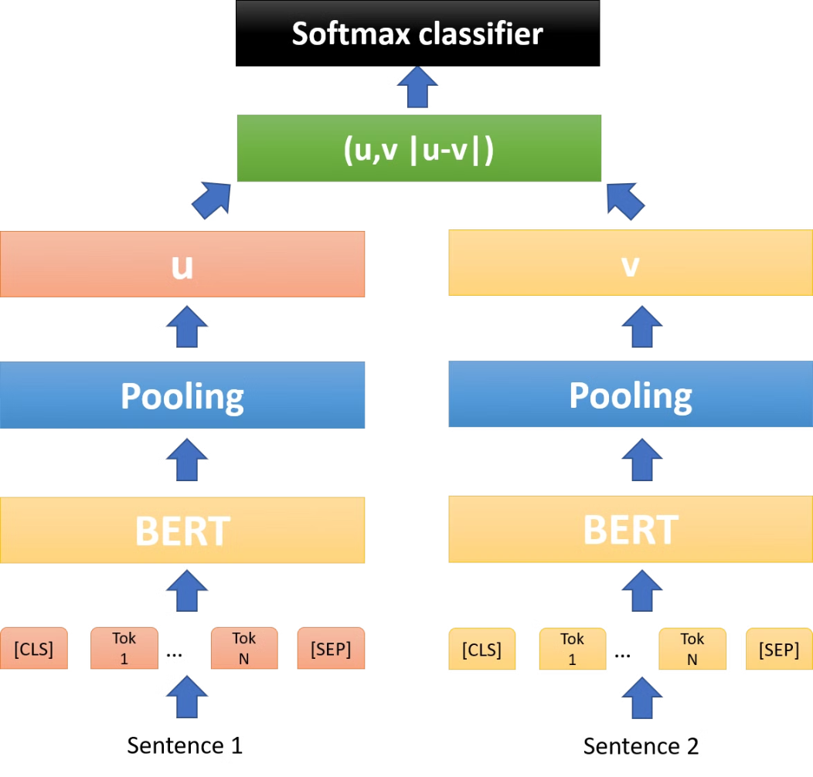
Why SBERT?
SBERT modifies BERT to derive meaningful sentence embeddings.
It is ideal for tasks like similarity, clustering, and classification.
Model: all-MiniLM-L6-v2 balances performance and speed.
1
Direct Comparison
2
Speed
Embeddings can be directly compared using cosine similarity.
Significantly speeds up pairwise comparison and clustering tasks.
3
Architecture
Uses a Siamese BERT architecture. Passes sentence pairs through BERT.

Slide 10
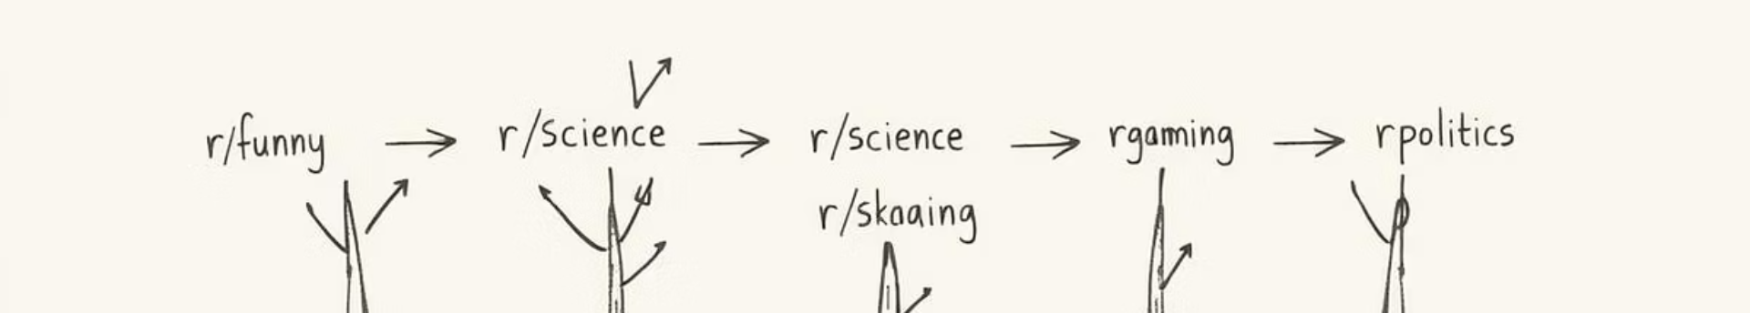



Classification with Random Forest
Model Training
Accuracy
Error Analysis
A Random Forest classifier was trained to predict the subreddit origin of posts using SBERT embeddings. The model's performance was rigorously evaluated.
The model achieved 63% accuracy, demonstrating its ability to distinguish between different mental health subreddits based on textual content.
Error analysis revealed confusion between depression and mentalhealth, likely due to thematic overlap. This highlights the complexities of mental health discourse.

Slide 11

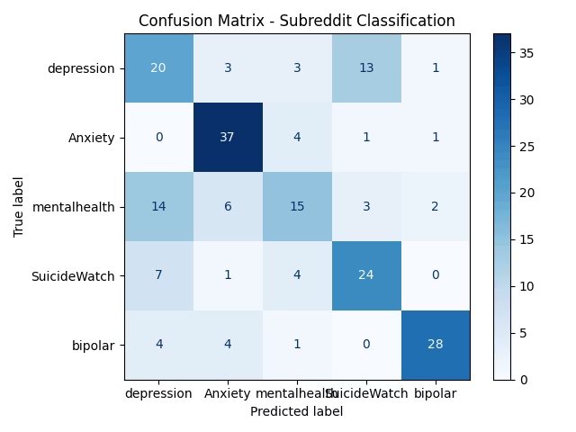
Confusion Matrix
The Random Forest classifier achieved 63% accuracy.
SBERT embeddings were used as features.
The task was to predict the subreddit for each post.
Performance
Balanced Accuracy
Model distinguishes posts based on writing.
bipolar: 88%
depression: 44%
There is overlap between content.
The confusion matrix shows correct predictions on prime diagonal.
Off-diagonal errors reflect thematic overlaps between subreddits.

Slide 12
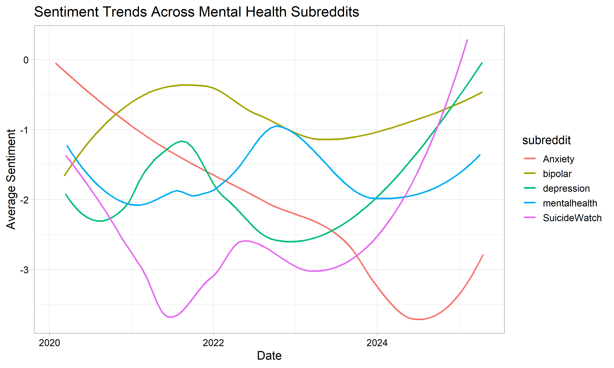
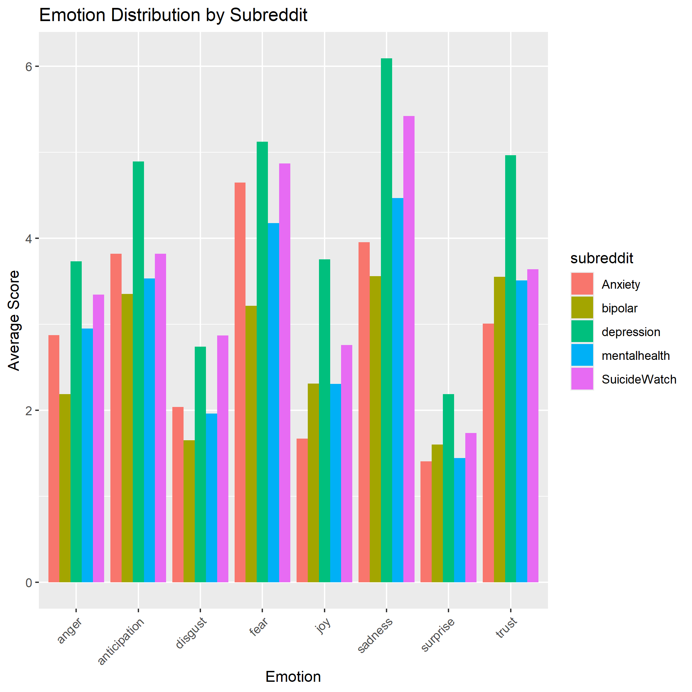
Sentiment Trends and Emotion Distribution

Slide 13
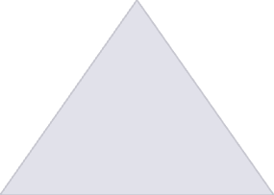


Sentiment Trends and Emotion Distribution
Declining Sentiment
1
Sentiment declined initially during the pandemic.
Signs of Recovery
2
Sentiment showed recovery post-2024.
Dominant Emotions
3
Sadness, trust, and anticipation were consistently dominant emotions.
The analysis of sentiment trends over time reveals a clear decline in the early stages of the pandemic, followed by gradual recovery post-2024. Emotion distribution across subreddits indicates that sadness, trust, and anticipation are consistently dominant.

Slide 14
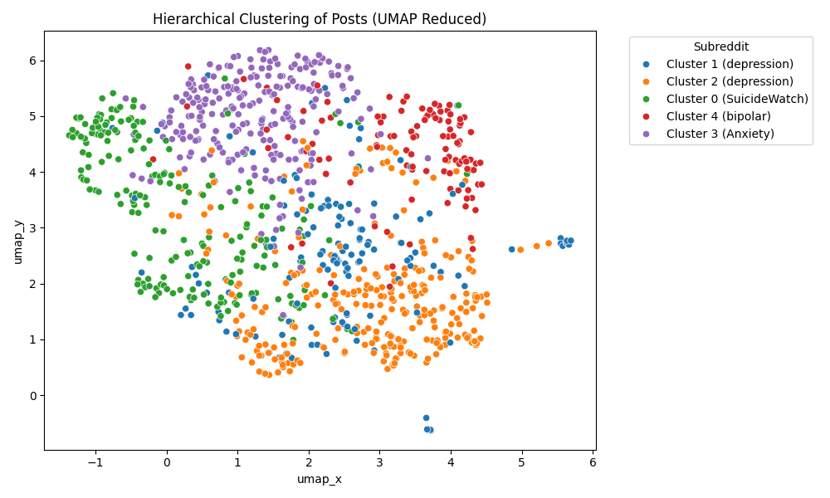
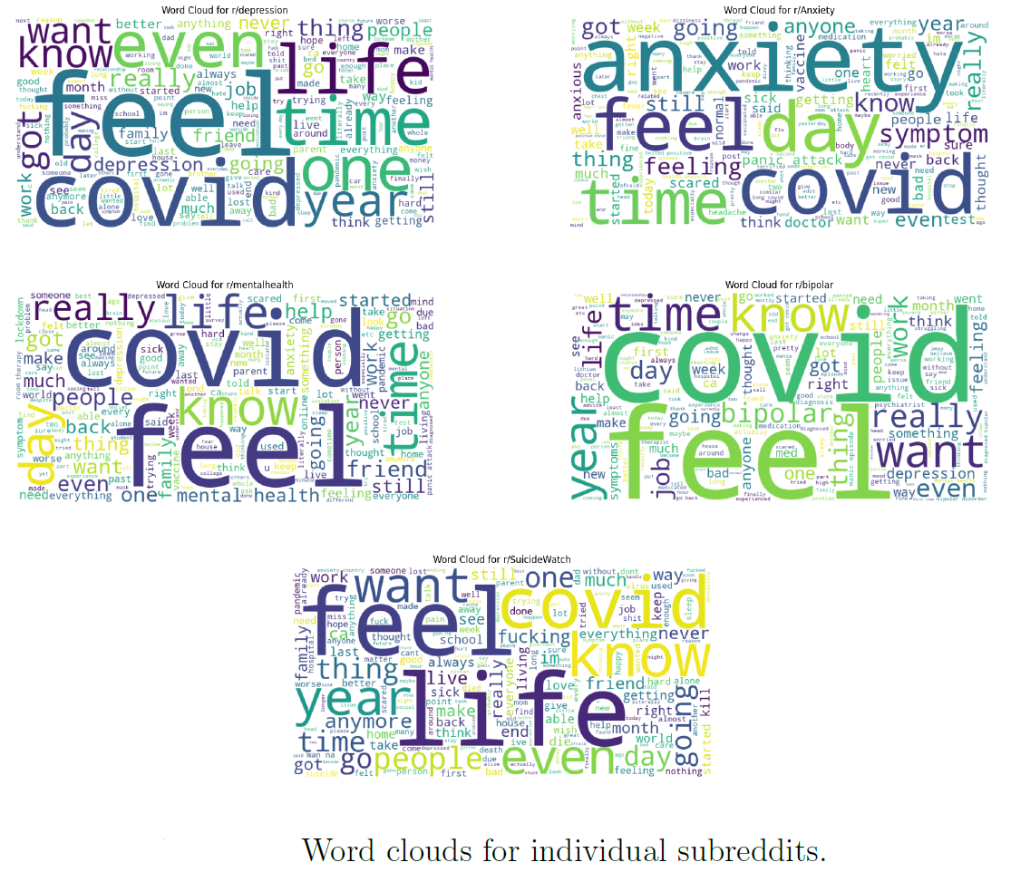
UMAP Clustering and Word Clouds

Slide 15
UMAP Clustering and Word Clouds
UMAP Clusters
1
UMAP-based clustering exposed nuanced post groupings beyond subreddit labels. This revealed underlying themes in the discussions.
Word Clouds
2
Word clouds indicated subreddit-specific concerns (e.g., "mania" in bipolar, "lonely" in SuicideWatch). These visualizations provided insights into the unique challenges faced by each community.
Misclassifications
3
Misclassifications in subreddit prediction reflected overlapping psychological concerns across communities. This highlights the interconnectedness of mental health issues.

Slide 16
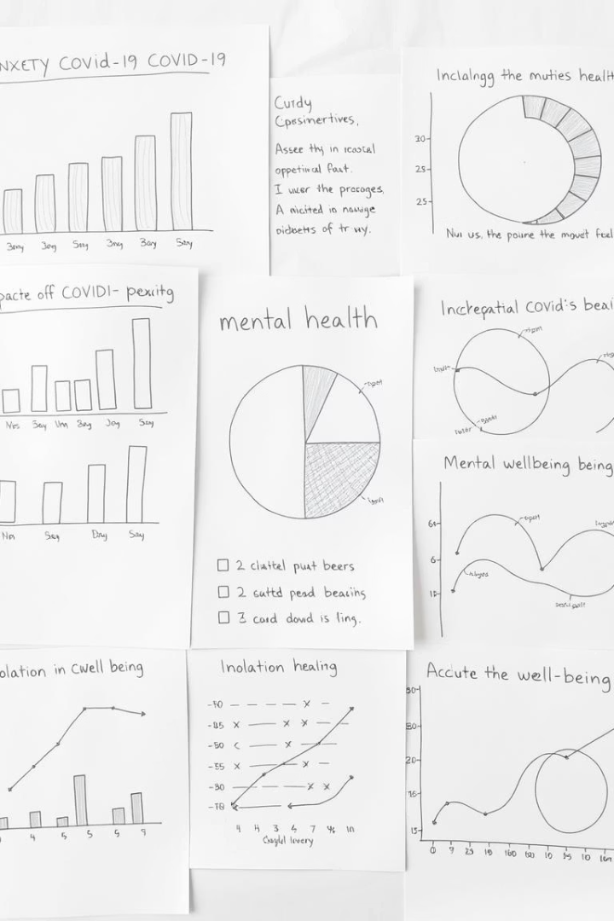
Key Results and Discussion
63%
5
Model Accuracy in Subreddit Prediction
Distinct Clusters Identified Through UMAP
2024
Year Sentiment Showed Signs of Recovery
Our results reveal declining sentiment in early pandemic stages with gradual recovery post-2024. High levels of sadness, trust, and anticipation were observed. SBERT clustering exposed nuanced post groupings beyond subreddit labels, while word clouds indicate subreddit-specific concerns. Misclassifications in subreddit prediction reflect overlapping psychological concerns across communities.

Slide 17




Significance and Conclusion
This study provides insights into mental health challenges during the COVID-19 pandemic.
Real-Time Surveillance
This study demonstrates the utility of Reddit as a source for real-time mental health surveillance.
Targeted Interventions
Mental health experts can use these insights to develop targeted interventions.
Policy Adjustments
Policymakers can use these findings to address mental health in crises.
Long-Term Research
Researchers can explore the long-term mental health effects of the pandemic.
This project demonstrates the potential of social media data to gain real-time insights into mental health.

Slide 18
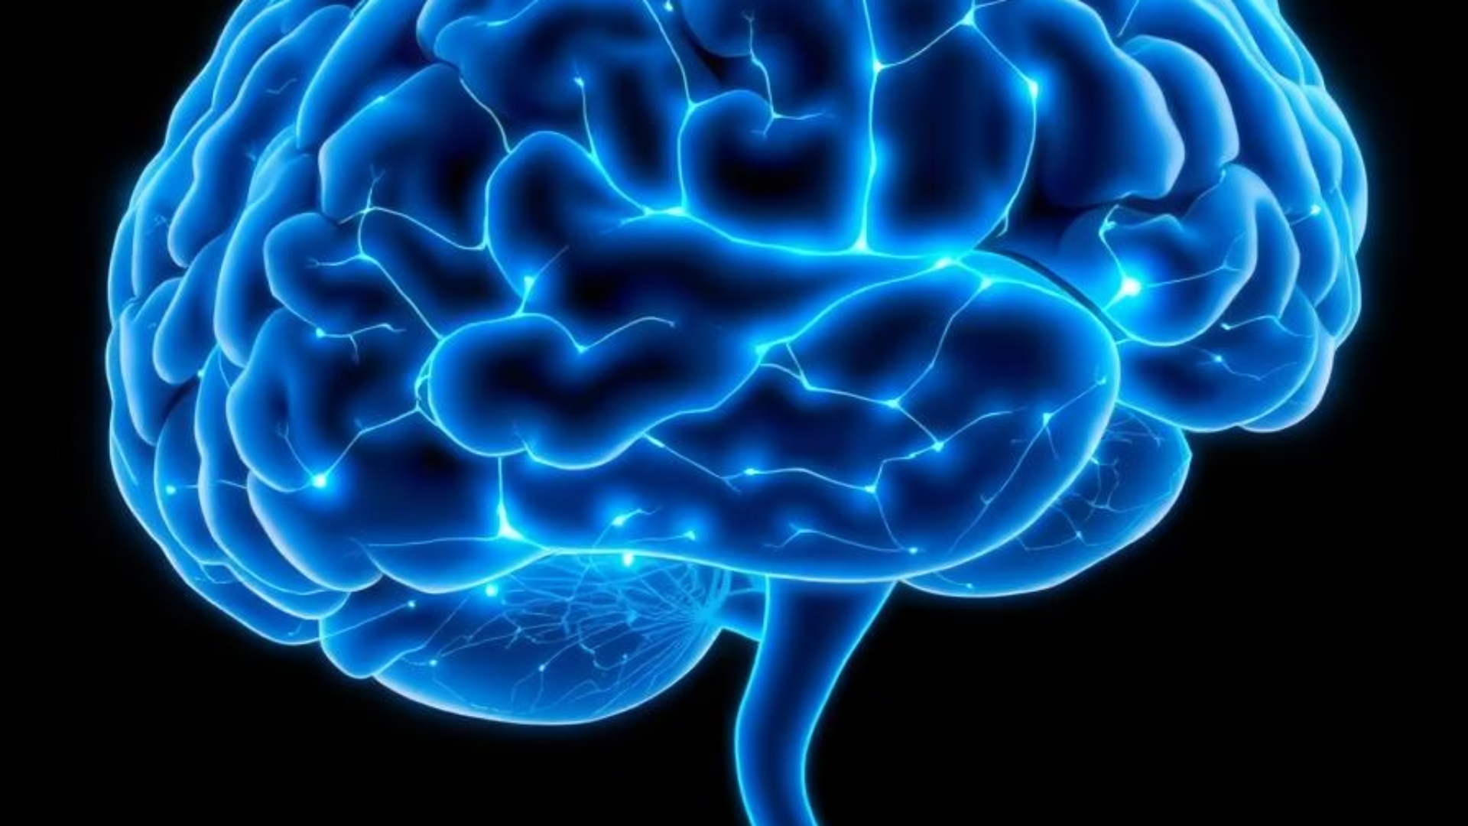
Future Work
COVID-19 as Trigger
Bidirectional Relationship
Neurological Impact
Vulnerable Populations
Investigate COVID-19 as a trigger for new mental health issues. Develop mental health screening for COVID-19 patients.
Study SARS-CoV-2's neuroinvasive effects and CNS impact. This opens avenues for neurological research.
Explore the relationship between COVID-19 and mental health. Comprehensive care should address both physical and mental health.
Investigate why psychiatric patients are at higher risk for COVID-19. Inform targeted preventive measures and care strategies.

Slide 19
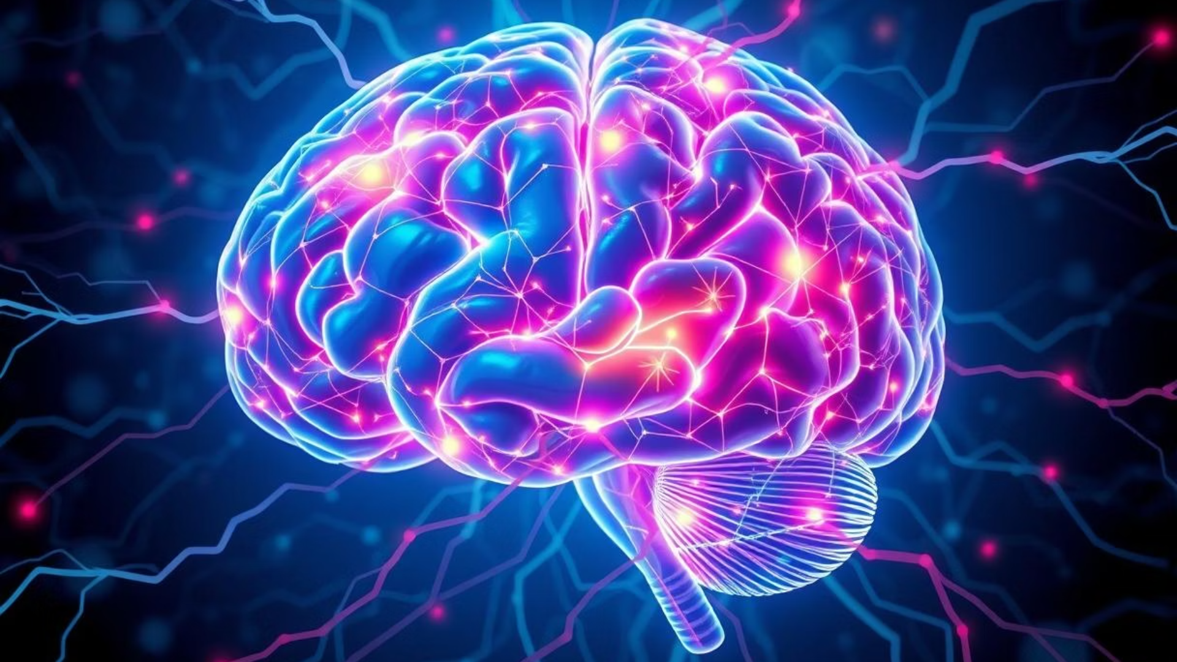
Future Work
Comparative Analysis
Advanced Sentiment Analysis
Longitudinal Study
Compare insights with other mental health subreddits for broader context.
Integrate ML for nuanced sentiment classification beyond basic emotions.
Track long-term mental health impacts post-pandemic. Evaluate recovery.

Slide 20

Thank You

